Slide 1
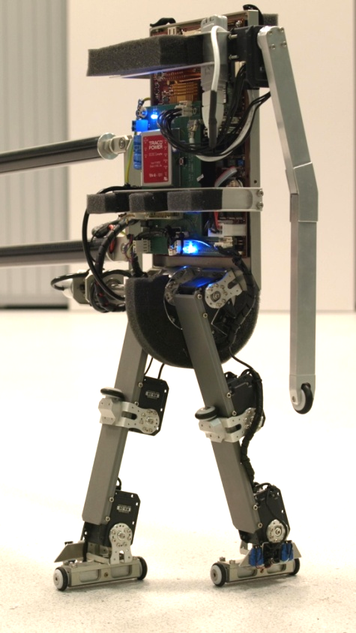
Speeding-up Reinforcement Learning using Prioritized Sweeping and Model-building techniques
Introductory Colloquium
Thijs Ramakers
Supervisors: prof. dr. R. Babuška
dr. G. Lopes
E. Schuitema, M.Sc
October 2, 2009
<number> of 24
Delft Center for Systems and Control
Notes:
Hello everybody, thanks for being present here.
Introduction to by Msc thesis, titled ‘speeding up reinforcement learning using prioritized sweeping and model-building techniques’

Slide 2
Overview
Introduction
Reinforcement learning
Model-learning solution approach
Research
  Model-building
  Prioritized sweeping
Preliminary results
Conclusions / Future work
October 2, 2009
<number> of 24

Slide 3

Introduction: why learning?
Many applications:
    Autonomous robots
    Learn from experiences
    Adapt to changes
    Learn from mistakes
    Find non-trivial solutions
October 2, 2009
<number> of 24
Notes:
Learning can be used in several cases:
Complex problems that are difficult to analyze
Autonomous robots that should learn without a supervisor
Systems in a changing environment could use learning to adapt.
Systems can learn from their mistakes

Slide 4
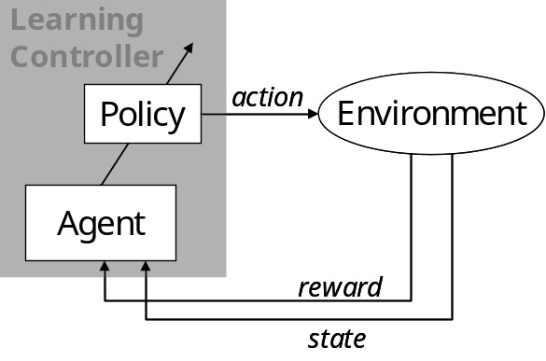
Reinforcement Learning
 |  |  |  |  |  | G
 |  |  | S
At each time step:
Process is in a state
Controller takes action
according to its policy
Process makes transition into next state
Controller receives reward
2D grid example:
56 states
4 actions
Reward:
+1, goal state
0, elsewhere
October 2, 2009
<number> of 24
Notes:
RL is derived from the idea that past experiences can be used for future behavior. RL is trial and error.
System is in a state that fully describes the system. An action is tried, a scalar reward is the received feedback. Agent’s goal: maximize the reward that is received during an episode. The action in every state is the policy. This process is called a Markov Decision Process.
State
Action
Policy
State transition function (probabilistic / deterministic)
Reward function

Slide 5
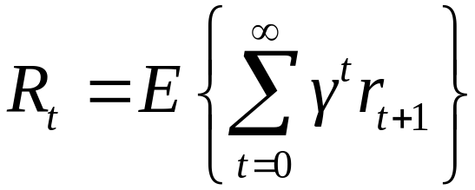
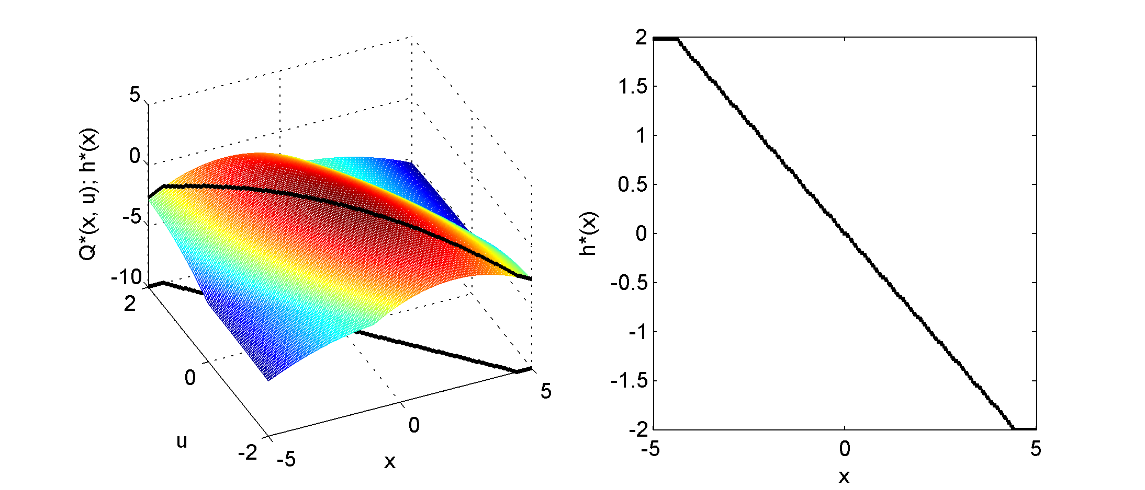
Reinforcement Learning goal
Learning goal:
Find a policy that maximizes return
Value function represents expected return
for each state-action pair
Find value function to solve problem
October 2, 2009
<number> of 24
Notes:
The goal for a RL controller is to maximize the expected (discounted) return.
Every state-action pair can be given a value. This value is the expected total reward under a certain policy. The optimal policy maximizes this return.

Slide 6
Solving a Reinforcement Learning problem
Solution: Different algorithms for finding value function
Method: By using a model or by interaction with real setup
Problem: State-space is usually very large
Many discrete states
Many dimensions
Continuous state-variables
October 2, 2009
<number> of 24
Notes:
RL problems can be solved for relatively simple problems. For larger problems, learning becomes slow due to:
Continuous states. VF has to be approximated and a state is never encountered twice.
High number of dimensions: leads to a very high number of states. Makes it very difficult to determine VF for the total state-space
Slow propagation of information: Once the goal is found, this information propagates through the state-space very slowly.
This last problem is dealt with in the work.

Slide 7

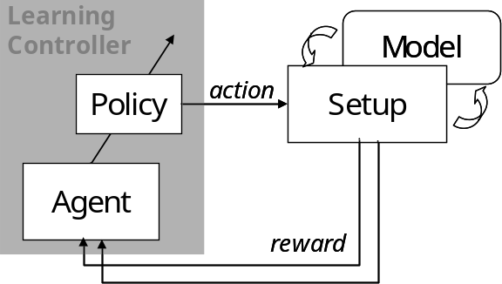
Model-learning approach
No model available, but interaction with setup only is not sufficient
Build a state-transition model:
Use model to re-live experiences (‘dreaming’)
More experiences to fill state-space
Use model and setup simultaneously
state
October 2, 2009
<number> of 24
Notes:
Several solution approaches exist. We will focus on the model-learning approach.
Model-learning:
No a priori model is available, but model is learned during the learning process.
Solution method: Switching between on-line (model-free) and off-line (model-based) learning.
The model is used to generate more experiences to learn from. The same update rule is used for the model and the setup. Fill total sample interval with model-based experiences.

Slide 8
Prioritized Sweeping
Improve learning speed using the model
Visit states according to a priority queue:
work back from goal
Improved information propagation
through state-space
Research value: new for large, continuous
state-spaces and real setups
 |  | 4 | 3 | 2 | 1 | G
 |  |  | 4 |  | 2 | 1
 |  |  |  |  | 3 | 2
 |  |  |  |  | 4 | 3
 |  |  |  |  |  | 4
2D grid example
October 2, 2009
<number> of 24
Notes:
Prioritized sweeping makes sure state-action pairs are updated that will possibly lead to the fastest learning. The model is used to generate a state-transitions that will lead the system into a valuable state.
Advantages:
The model is used to generate state-transitions into valuable states.
Information is propagated through state-space faster, as only valuable states are visited.
Challenges:
How to build a model
How to obtain an accurate model from only a limited number of experiences
Can the model be used to look multiple steps ahead?

Slide 9
Problem statement
Problem: Solving a complex RL task is slow
A possible method for speeding-up:
  Model-learning combined with Prioritized sweeping
How can Model-learning and Prioritized Sweeping techniques be used to speed-up Reinforcement Learning?
Research question:
October 2, 2009
<number> of 24
Notes:
Learning has been applied to relatively simple problems. For more complex systems, learning can take very long.
Prioritized sweeping is a technique that could speed up learning, although it has not been used much in complex systems.
Research question: ‘How can prioritized sweeping be used to speed up reinforcement learning?’ As I will show, this question breaks up into two research directions.

Slide 10
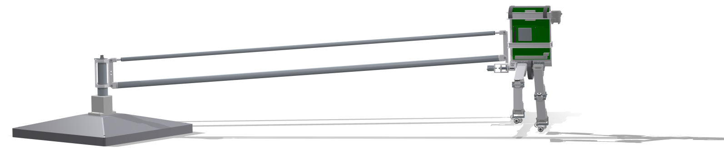
Application
Application of model-learning and prioritized sweeping on a complex setup
Test platform: a humanoid robot called ‘Leo ‘
October 2, 2009
<number> of 24
Notes:
We are interested in applying prioritized sweeping on complex setups.
A test-platform is currently being build for DCSC.

Slide 11
Robot Leo
Two-legged humanoid robot
2 dimensional walking
Test platform for learning experiments
  (walking in circles)
Actions:
  7 Actuators
States:
  8 x angle
  8 x angular velocity
  (Force sensors in feet)
October 2, 2009
<number> of 24
Notes:
Robot Leo is a two-legged humanoid robot specifically designed for performing learning experiments. The walking is 2-dimensional, as the robot cannot fall sideways. It is convenient for learning experiments as the robot walks in circles (in theory infinitely long).
The robot has 7 actuators (6 for walking) and 16 states.

Slide 12
Research
Research will be divided into two parts:
  Model-building: how to build a model that is accurate, even in high dimensional problems?
  Prioritized Sweeping: how to include Prioritized Sweeping in the learning process?
October 2, 2009
<number> of 24
Notes:
In order to use prioritized sweeping, an accurate model is needed which is not trivial. Therefore, the research naturally breaks down into two parts:
Model-building (how to build an accurate model from a limited number of experiences in high-dimensional problems)
PS (how to include PS)

Slide 13
Model-building demands
Demands:
  Dealing with continuous state variables
  Model non-linear system
  Estimate model from few observations
  Good accuracy
  Applicable to high dimensional problems
  Efficient in CPU & memory usage
October 2, 2009
<number> of 24
Notes:
Demands for the model-building technique:
Continuous states
Learning from few observations
Good accuracy (only in parts of state space?)
High dimensional problems
Efficient in CPU/memory usage (has to be applied in real time)

Slide 14
Memory-based learning
Memorize all past experiences
Advantages:
    Local approximation of function
    No global structure needed
    New experiences are used immediately
Disadvantages:
    Storing large dataset
    Noise sensitive
October 2, 2009
<number> of 24
Notes:
Focus on a type of model-building technique called memory-based. A large number of experiences is simply stored in memory and used when needed.
Advantages:
Function can be approximated locally
No global structure is needed
Disadvantages:
Large dataset has to be stored.
Noise sensitive

Slide 15

Local Linear Regression
        Store observed experiences
        (state, action → next state)
        Search K nearest samples
        Estimate linear model:
        Results in a piece-wise linear model
y
y_{q}
(K = 5)
X_{q}
X
October 2, 2009
<number> of 24
Notes:
The K-Nearest Neighbor method also relies on storing past input-output pairs.
The estimated output is simply obtained by averaging the output of the K nearest stored inputs. Calculating the distances of all samples is the most computationally heavy.
K can be seen as a measure for the amount of generelization.
Local Linear Regression can be seen as an extension to KNN. Instead of averaging the outputs, a linear model is fitted to the K data samples. This leads to a piece-wise linear model.
A simple Least Squares approach can be used. Weighted Least Squares is also possible to give a higher weight to close samples.

Slide 16
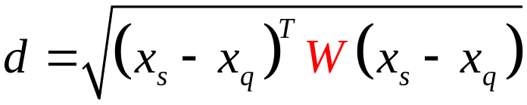

Weighted Linear Regression
        Extend Local Linear Regression with weights
        Distance measure
        (which samples to use?)
        Linear regression
        (how to use them?)
October 2, 2009
<number> of 24
Notes:
The K-Nearest Neighbor method also relies on storing past input-output pairs.
The estimated output is simply obtained by averaging the output of the K nearest stored inputs. Calculating the distances of all samples is the most computationally heavy.
K can be seen as a measure for the amount of generelization.
Local Linear Regression can be seen as an extension to KNN. Instead of averaging the outputs, a linear model is fitted to the K data samples. This leads to a piece-wise linear model.
A simple Least Squares approach can be used. Weighted Least Squares is also possible to give a higher weight to close samples.

Slide 17
Research
Various setups:
  Simple simulations (Matlab)
  Robot Leo simulation (Open Dynamics Engine)
  Robot Leo real setup
Complexity
October 2, 2009
<number> of 24
Notes:
The model-building techniques relie on stored input-output pairs.
Storing all experiences is impossible, especially after many experiences. A decision has to be made in which experiences should be stored and which can be ignored.
Generelization ←→ Approximation

Slide 18

Model-building research
Increase problem dimension
  Start with one leg
  Increase towards full robot
Use weights to increase model accuracy
Add noise to simulation and
  compare with real setup
October 2, 2009
<number> of 24
Notes:
The model-building techniques relie on stored input-output pairs.
Storing all experiences is impossible, especially after many experiences. A decision has to be made in which experiences should be stored and which can be ignored.
Generelization ←→ Approximation

Slide 19
Prioritized sweeping research
  Use results from model-building research
  Add a learning task
  Increasingly complex learning tasks
  One leg (learning task: kick a ball)
  Full robot (learning task: walking)
October 2, 2009
<number> of 24
Notes:
Second part of the research will deal with prioritized sweeping. This is the actual learning part of the research.
Several interesting research directions:
Different ways to fill the priority queue (several methods exist in literature)
What is the effect of an inaccurate model (on learning speed and quality of policy)
Early applications of PS where applied on discrete problems. How can we deal with continuous states and function approximation?
Until now, only 1-step look ahead has been used. Can the model be used to look multiple steps ahead?

Slide 20
Prioritized sweeping research
  Possible effects of an inaccurate model
    Slower learning
    No optimal policy found
  Multi-step look ahead
    Use model to look forward
  Exploration strategies
    Avoid sub-optimal solution
October 2, 2009
<number> of 24
Notes:
Second part of the research will deal with prioritized sweeping. This is the actual learning part of the research.
Several interesting research directions:
Different ways to fill the priority queue (several methods exist in literature)
What is the effect of an inaccurate model (on learning speed and quality of policy)
Early applications of PS where applied on discrete problems. How can we deal with continuous states and function approximation?
Until now, only 1-step look ahead has been used. Can the model be used to look multiple steps ahead?

Slide 21
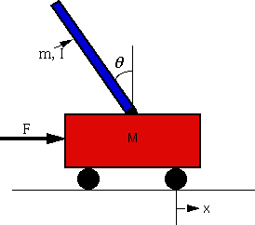
Preliminary results
Simulation of an inverted pendulum (non-linear system)
Closed loop (LQ feedback)
Inverted
pendulum
r = 0
u
state
LQ
feedback
Memory: N samples (state, next state)
generated randomly
October 2, 2009
<number> of 24
Notes:
Finally a small overview of the current state of the project.
Leo is currently being build, but a simulation has already been made
Gaining experience with different model-building techniques and simulation software
Future work:
Research model-building techniques on simple setups. (for example use only one of Leo’s legs)
Compare simulation results with real setup results (what are problems we encounter?)
Increase complexity toward the full robot.

Slide 22
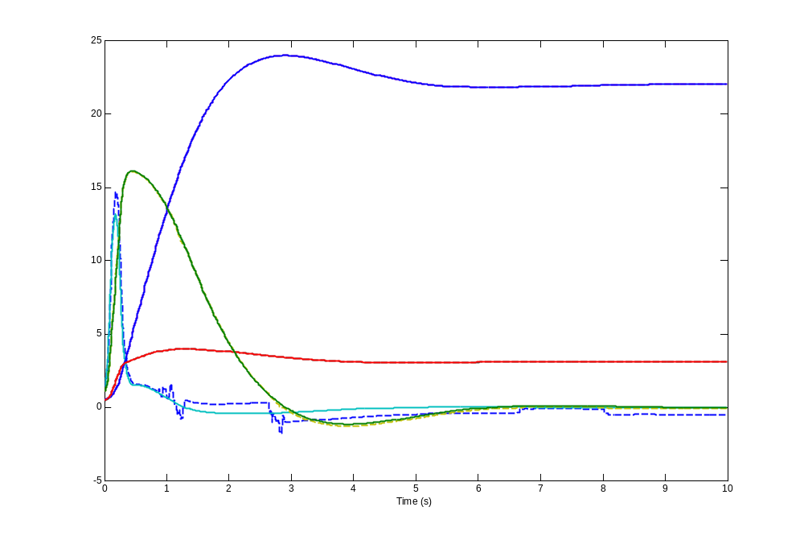
Inverted pendulum results
Local Linear Regression
N = 1000
K = 50
No weights
Can the modeling errors be reduced by adding weights?
What is the effect on the learning process?
Solid: System response
Dashed: LLR estimate
October 2, 2009
<number> of 24
Notes:
Finally a small overview of the current state of the project.
Leo is currently being build, but a simulation has already been made
Gaining experience with different model-building techniques and simulation software
Future work:
Research model-building techniques on simple setups. (for example use only one of Leo’s legs)
Compare simulation results with real setup results (what are problems we encounter?)
Increase complexity toward the full robot.

Slide 23
Conclusions
Model-learning and Prioritized Sweeping can speed up reinforcement learning in complex tasks.
Local Linear Regression can build a reasonably accurate model of the system.
Add weights to obtain a better estimate
Apply model-building on more complex problems
Future work
October 2, 2009
<number> of 24
Notes:
I would like to conclude with an overview of the total project.
I will research two important aspects of PS:
Different techniques for building a state-transition model
Influence of PS on learning speed
Application on increasingly complex setups
Finally: Application of PS on robot Leo (Leo learns to walk?)

Slide 24
Questions, Comments, Suggestions?
October 2, 2009
<number> of 24
Notes:
Are there any questions? Or suggestions?

